Slide 1
Intro to Programming
Class 9 – 22 Sept 2016
Ms. Santos

Slide 2
Goals:
Goal 1: You will learn how to implement an if-else statement in Javascript.
Goal 2: You will learn how to implement an if-else if statement in Javascript.
Goal 3: You will learn how to use operators in conditional statements.
Code
if () {} else {}
if () {} else if () {}
<
>
<=
>=
!=

Slide 3
Error Checking:
H15 – PasswordValidation.html

Slide 4
PassowrdVaidations - Flowchart
Get password and save
If password is abc$123, alert “Welcome”
If password not is abc$123, alert “I don’t know you”

Slide 5
PasswordValidationPseudocode
save master_password
get password from the user
If password = master_password
say welcome
If not anything else
say I don’t know you

Slide 6
PasswordValidationPseudocode
save master_password
get password from the user
If password = master_password
say welcome
If not anything else
say I don’t know you
How do we do this in java?

Slide 7
If-else
In Java:
if (condition) {
//code
} else {
//code
}

Slide 8
Error Checking:
Now finish:
H15 – PasswordValidation.html

Slide 9
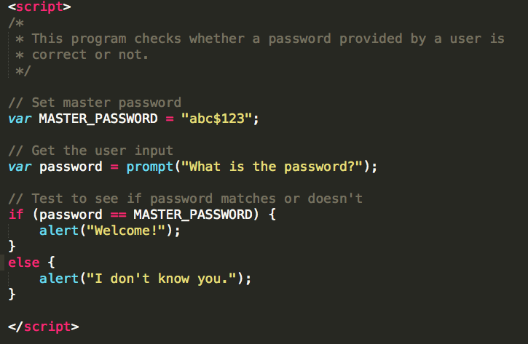

Slide 10
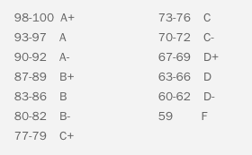
Checking in a range:
GradeCalculator.html
Create a calculator that outputs the letter grade from a number grade from a user.
Use ASL’s High School grade range:

Slide 11
GradeCalcuclator Algorithm
Ask for the grade
Start a message with “The letter grade is”
If grade is below 59
Concatenate F to the message
If grade is below 62
Concatenate D- to the message
If grade is below 66
Concatenate D to the message
If grade is below 69
Concatenate D+ to the message
…
If grade is below 100
Concatenate A+ to the message
Display message

Slide 12
GradeCalcuclator Algorithm
Ask for the grade
Start a message with “The letter grade is”
If grade is below 59
Concatenate F to the message
If grade is below 62
Concatenate D- to the message
If grade is below 66
Concatenate D to the message
If grade is below 69
Concatenate D+ to the message
…
If grade is below 100
Concatenate A+ to the message
Display message
How do we do multiple if statements?

Slide 13
If-else if
In Java:
if (condition) {
//code
} else if (condition){
//code
} else if (condition) {
//code
} else {
//code
}
Optional

Slide 14
Operators
We use symbols in Processing called operators to create conditions.
**NOTE: Be sure to use the double equal sign (==) when defining an equal-to condition
Symbol | Definition
== | Equal to
!= | Not equal to
> | Greater than
< | Less than
>= | Greater than or equal to
<= | Less than or equal to

Slide 15
Checking in a range:
Now finish:
GradeCalculator.html

Slide 16
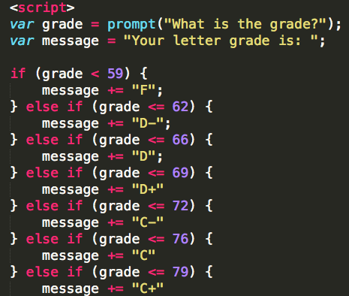
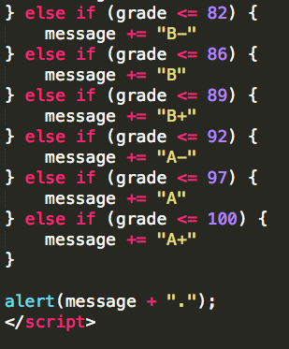

Slide 17
Goals:
Goal 1: You will learn how to implement an if-else statement in Javascript.
Goal 2: You will learn how to implement an if-else if statement in Javascript.
Goal 3: You will learn how to use operators in conditional statements.
Code
if () {} else {}
if () {} else if () {}
<
>
<=
>=
!=

